Slide 1

Wandering with Google Maps in Kotlin
Meghan Mehta

Slide 2

You will learn:
Obtain an API key.
Integrate a Google Map in your app.
Display different map types.
Style the Google Map.
Add markers to your map.
Enable the user to place a marker on a point of interest.
Enable location tracking.
Notes:
You will learn how to
Obtain an API key.
Integrate a Google Map in your app.
Display different map types.
Style the Google Map.
Add markers to your map.
Enable the user to place a marker on a point of interest (POI).
Enable location tracking.

Slide 3
Demo: Final App
Notes:
You will use these new skills to create the Wander app, which displays a Google Map with custom styling. The Wander app allows you to drop markers onto locations, add overlays and see your location in real time.

Slide 4
Create a Google Maps project

Slide 5
Demo: Make Project
Notes:
Create a new Android Studio project.
Select the Google Maps Activity template.
Name the project Wander.
Make sure the language is Kotlin.
Click finish.

Slide 6
Demo: Look at files
Notes:
When I created a new project with the Google Maps project template, it makes a bunch of files for me. It creates an activity, called MapsActivity and an associated layout file. It also creates google_maps_api.xml, which is a configuration file for maps. It holds, among other things, the api key. Let's take a look more closely at each.
The first file we will look at is MapsActivity.java
The MapsActivity.kt file instantiates the SupportMapFragment in the onCreate() method. The SupportMapFragment is a way to place a map in an application.
The class's getMapAsync() method is also called to prepare the Google Map.
When this finishes the onMapReady() callback is called. The activity that contains the SupportMapFragment must implement the OnMapReadyCallback interface and that interface's onMapReady() method.
The onMapReady() method is called when the map is loaded.
Currently onMapReady sets the class variable of mMap to the map passed in. It then takes the LatLng coordinates of sydney, adds a marker there and moves the camera there.
Now let us open the layout file activity_maps.xml
This layout file contains a single fragment called SupportMapFragment, that fills the entire screen.
Next thing the template provides is google_maps_api.xml
You use this configuration file to hold your API key. The template generates two google_maps_api.xml files: one for debug and one for release. The file for the API key for the debug certificate is located in src/debug/res/values. The file for the API key for the release certificate is located in src/release/res/values. In this practical you only use the debug certificate.

Slide 7
Getting an API key

Slide 8
API Key
A unique identifier that is used to authenticate requests associated with your project for usage and billing purposes.
Tied to a digital certificate that links the app to its author.
Notes:
To use Google Maps you need an API key.
An API key is A unique identifier that is used to authenticate requests associated with your project for usage and billing purposes. The API key is tied to a digital certificate that links the app to its author. In this case we want access to the Google Maps API and all its functionality.

Slide 9
Debug Certificate
The Android SDK tools generate this certificate automatically when you do a debug build.
Only use this certificate with apps that you're testing.
Do not attempt to publish an app that's signed with a debug certificate.
Notes:
Use the API key for the debug certificate. The debug certificate is insecure by design, as described in Sign your debug build.
The IDE automatically creates the debug keystore and certificate in $HOME/.android/debug.keystore, and sets the keystore and key passwords.
Because the debug certificate is created by the build tools and is insecure by design, most app stores (including the Google Play Store) do not accept apps signed with a debug certificate for publishing.

Slide 10
Release Certificate
The Android SDK tools generate this certificate when you do a release build.
You can also generate this certificate using the keytool program.
Use this certificate when you are ready to release your app to the world.
Notes:
Published Android apps that use the Google Maps API require a second API key: the key for the release certificate. For more information about obtaining a release certificate, see Get API Key linked below.

Slide 11
Demo: Get API key
Notes:
Let’s get an API key so that we can connect to the maps API
Open the debug version of the google_maps_api.xml file. The file includes a comment with a long URL. The URL's parameters include specific information about your app like the package name, the fact that you want to use the Maps API, and the SHA-1 certificate which is what this long alphanumeric section is.
Copy and paste the URL into a browser.
Follow the prompts to create a project in the Google API Console. Because of the parameters in the provided URL, the API Console knows to automatically enable the Google Maps Android API
Create an API key and click Restrict Key to restrict the key's use. The Maps API can be used on many other platforms, you just want this key to be linked to Android apps.
The generated API key should start with AIza.
In the google_maps_api.xml file, paste the key into the google_maps_key string where it says YOUR_KEY_HERE.
Run your app. The API key may take up to 5 minutes to work. You have an embedded map in your activity, with a marker set in Sydney, Australia.
The Sydney marker is part of the template, and you change it later.

Slide 12
Demo: refactor map
Notes:
MapsActivity has a private lateinit var called mMap which is of type GoogleMap. By Kotlin naming conventions you will want to change it to be called map instead.
In MapsActivity, right click on mMap and click Refactor/Rename…
Change the variable name to map.
Notice how all the references to mMap in the onMapReady() function also change to map.

Slide 13
Adding Map types

Slide 14
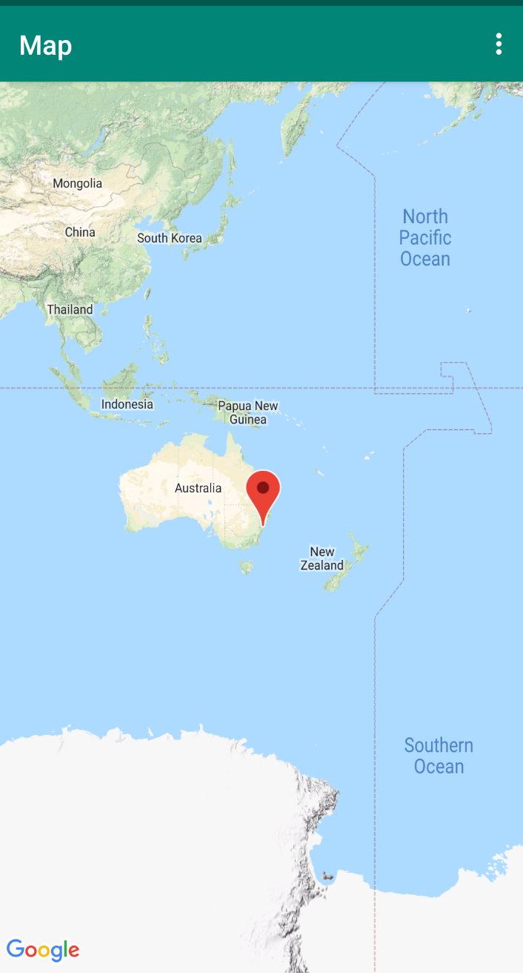
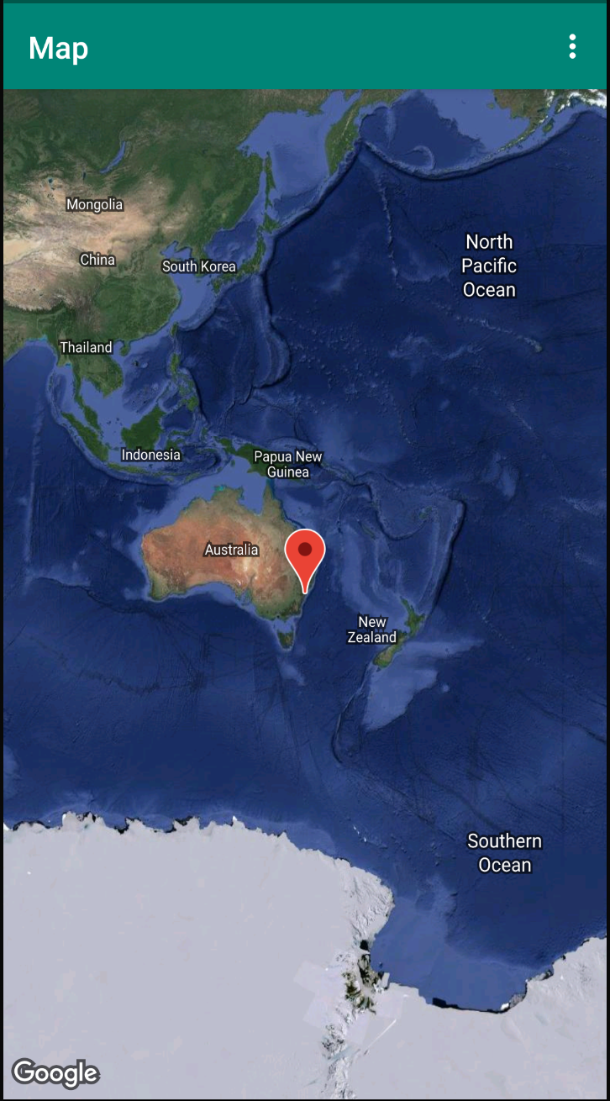
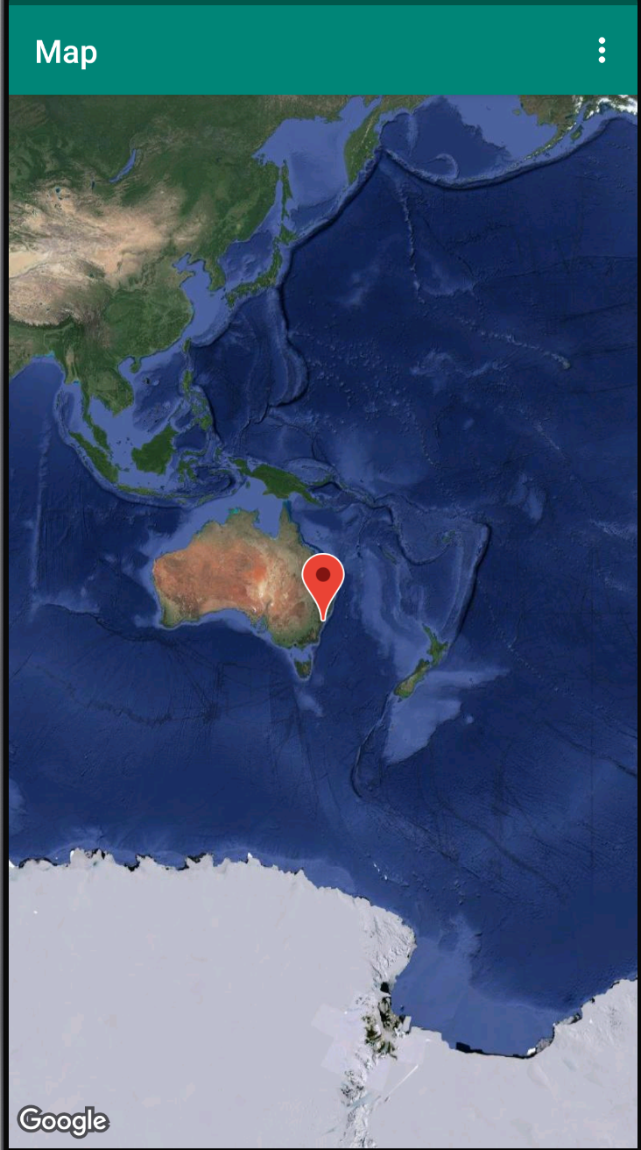
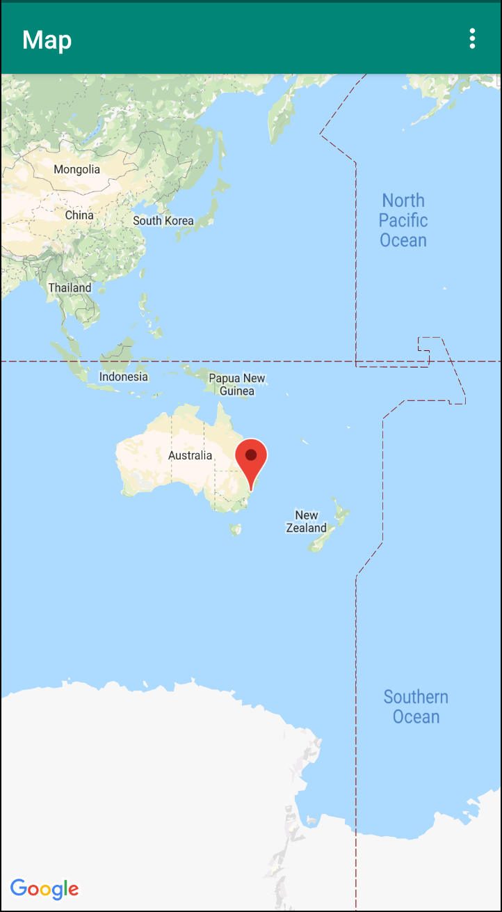
Map Types
Google Maps include several map types: normal, hybrid, satellite, terrain,
Notes:
Google Maps include several map types:
normal - which is the default map
Hybrid - displays a mixture of normal and satellite views.,
Satellite - displays Google Earth satellite images,
Terrain - displays a physical map based on terrain information,
The type of map that your user wants depends on the kind of information they need. For example, when you’re using maps for navigation in your car, it's helpful to see street names clearly - in this case you would use the normal option. When you are hiking, you probably care more about how much you have to climb to get to the top of the mountain - in this case you would use the terrain option.
Let’s add an app bar with an options menu that allows the user to change the map type.

Slide 15
Demo: Create menu
Notes:
To create a new menu XML file, right-click on your res directory and select New > Android Resource File.
In the dialog, name the file map_options. Choose Menu for the resource type. Click OK.
In the text tab, replace the code in the new file with the code below to create the map options. The "none" map type is omitted, because "none" results in the lack of any map at all.
You’ll notice there are errors in the file because the strings haven’t been defined. In strings.xml, add resources for the title attributes in order to resolve the errors.
In MapsActivity, override the onCreateOptionsMenu()

Slide 16
onCreateOptionsMenu()
Initializes the contents of the Activity's standard options menu. You should place your menu items in to menu.
This is only called the first time the options menu is displayed.
Notes:
Initializes the contents of the Activity's standard options menu. You should place your menu items in to menu.
This is only called the first time the options menu is displayed.

Slide 17
Demo: Override onCreateOptions
Notes:
In MapsActivity, override the onCreateOptionsMenu() method and inflate the menu from the map_options resource file:
To change the map type, you can set the map’s mapType() method to one of the map-type constants.
To change the map type, you can use the setMapType() method on the GoogleMap object, passing in one of the map-type constants.
Run the app, notice how there is a new part of the map, the three vertical buttons.
Click on them, there is a menu with options attached to it.
Click on the options, nothing happens, why?
You have not overridden the onOptionsItemSelected yet.
Next, override the onOptionsItemSelected() method.

Slide 18
onOptionsItemSelected()
This hook is called whenever an item in your options menu is selected.
Notes:
This hook is called whenever an item in your options menu is selected.
override the onOptionsItemSelected() method to change the map type when the user selects one of the menu options:
This tells you what to do when a menu option is selected

Slide 19
Demo: override onOptionsSelected
Notes:
Add a when statement to handle which item was selected
As you can see if the id is normal_map, the map type is set to normal, if the ID is hybrid, the map type is set to hybrid.
Run the app. Use the menu in the app bar to change the map type. Notice how the map's appearance changes between the different modes.
Demo map appearances changing

Slide 20
Adding Markers

Slide 21
onMapReady()
Triggered when the map is ready to be used and provides a non-null instance of GoogleMap.
This method will only be triggered when the user has installed Google Play Services.
Notes:
Triggered when the map is ready to be used and provides a non-null instance of GoogleMap. This method will only be triggered when the user has installed Google Play Services. If they havent then they will be prompted to.

Slide 22
Demo: Remove code from onMapReady
Notes:
In the onMapReady() method, lets remove the code that places the marker in Sydney and moves the camera

Slide 23
Demo: Get home coordinates
Notes:
Create a new LatLng object called home. A LatLng is pretty self explanatory, it is an object that represents a pair of latitude and longitude coordinates. Find the latitude and longitude of your home.
Open Google Maps.
Right-click the place or area on the map.
Select What's here?
At the bottom, you’ll see a card with the coordinates.
Pass in the coordinates you just found.
Move the screen to home by calling the moveCamera() function on the GoogleMap object. Pass in a CameraUpdate object.

Slide 24
CameraUpdate
Defines a camera move.
Uses CameraUpdateFactory.newLatLngZoom() which returns a CameraUpdate that moves the center of the screen to a latitude and longitude specified by a LatLng object, and moves to the given zoom level.
Notes:
Move the screen to home by calling the moveCamera() function on the GoogleMap object. Pass in a CameraUpdate object which defines a camera move using CameraUpdateFactory.newLatLngZoom() this returns a CameraUpdate that moves the center of the screen to a latitude and longitude specified by a LatLng object, and moves to the given zoom level.

Slide 25
Zoom Level
1: World
5: Landmass/continent
10: City
15: Streets
20: Buildings
Notes:
The zoom level controls how zoomed in you are on the map. The following list gives you an idea of what level of detail each level of zoom shows:
1: World
5: Landmass/continent
10: City
15: Streets
20: Buildings
Add a marker to the map at your home.
Run the app. The map should pan to your home and zoom into the desired level.

Slide 26
Demo: Move Camera
Notes:
Create a variable that maintains zoom level and set it to 15f and pass it in to the move camera method.
Run the app. The map should pan to your home and zoom into the desired level.
Try changing up the zoom level

Slide 27
Demo: Add Marker
Notes:
Run the app, the map will now be centered on your home, but no marker is there.
Call map’s add marker function.
Add marker takes in a MarkerOptions where you can set the position of the marker, in this case pass in the home object.
In MarkerOptions you can also control things like the icon, title, snippet and more.

Slide 28
Adding Markers on long click

Slide 29
onMapLongClick()
Called when the user makes a long-press gesture on the map, but only if none of the overlays of the map handled the gesture.
Implementations of this method are always invoked on the Android UI thread.
Notes:
In order to add a marker on long click you use the map’s onLongClick method.
Called when the user makes a long-press gesture on the map, but only if none of the overlays of the map handled the gesture.
Implementations of this method are always invoked on the Android UI thread.

Slide 30
Demo: Add onMapListener
Notes:
Create a method stub in MapsActivity called setMapLongClick() that takes a GoogleMap as an argument. Attach a long click listener to the map object.
Inside onMapLongClick(), call the addMarker() method. Pass in a new MarkerOptions object, with the position set to the passed-in LatLng:
At the end of the onMapReady() method, call setMapLongClick(). Pass in map.
Run the app. Touch and hold on the map to place a marker at a location. Tap the marker, which centers it on the screen.
When a marker is tapped, navigation buttons appear at the bottom-left side of the screen, allowing the user to use the Google Maps app to navigate to the marked position.

Slide 31
InfoWindow
An info window displays text or images in a popup window above the map.
Info windows are always anchored to a marker.
Their default behavior is to display when the marker is tapped.
Notes:
An info window displays text or images in a popup window above the map.
Info windows are always anchored to a marker.
Their default behavior is to display when the marker is tapped.

Slide 32
Demo: Add InfoWindow
Notes:
In setMapLongClick()’s setOnMapLongClickListener() lambda, create a snippet. A snippet is additional text that is displayed below the title. In your case the snippet displays the latitude and longitude of a marker.
Set the title of the marker to “Dropped Pin” and set the marker’s snippet to the snippet you just created.
Run the app. Touch and hold on the map to drop a location marker. Tap the marker to show the info window.

Slide 33
Add a POI Listener

Slide 34
onPoiClickListener()
A listener for POI taps.
Notes:
Called when the user makes a long-press gesture on the map, but only if none of the overlays of the map handled the gesture.
Implementations of this method are always invoked on the Android UI thread.
This click-listener places a marker on the map immediately when the user clicks on a POI. The click-listener also displays the info window that contains the POI name.

Slide 35
Demo: Add POI Click Listener
Notes:
Create a method stub in MapsActivity called setPoiClick() that takes a GoogleMap as an argument. In the setPoiClick() method, set an OnPoiClickListener on the passed-in GoogleMap:
In the onPoiClick() method, place a marker at the POI location. Set the title to the name of the POI. Save the result to a variable called poiMarker.
In setOnPoiClickListener function, call showInfoWindow() on poiMarker to immediately show the info window.
Call setPoiClick() at the end of onMapReady(). Pass in map.
Run your app and find a POI such as a park or a coffee shop. Tap on the POI to place a marker on it and display the POI's name in an info window.

Slide 36
Style your map

Slide 37
Demo: Create Map Style
Notes:
Navigate to https://mapstyle.withgoogle.com/ in your browser.
Select Create a Style.
Select the Retro theme.
Click More Options at the bottom of the menu.
In the Feature type list, select Road > Fill. Change the color of the roads to any color you choose (such as pink).
Click Finish. Copy the JSON code from the resulting pop-up window.
In Android Studio, create a resource directory in the res directory and name it raw.
Create a file in res/raw called map_style.json to put the JSON code into.
Paste the JSON code into the new resource file.
Create a TAG class variable above the onCreate() method for logging purposes.
In MapsActivity.kt, create a setMapStyle() function that takes in a GoogleMap.
To set the JSON style to the map, call setMapStyle() on the GoogleMap object.
Pass in a MapStyleOptions object, which loads the JSON file. The setMapStyle() method returns a boolean indicating the success of the styling. If the file can't be loaded, the method throws a Resources.NotFoundException.
Call the setMapStyle() method in the onMapReady() method passing in your GoogleMap object.
Note that - If you zoom out enough, the map will not show roads anymore so you will not see the pink.

Slide 38
Styling your marker

Slide 39
Demo: Style marker in onMapLongClick()
Notes:
In the onMapLongClick() method, add the following line of code to the MarkerOptions() of the constructor to use the default marker but change the color to blue using a BitmapDescriptorFactory which is used to create a definition of a Bitmap image, used for marker icons and ground overlays.
Run the app. The markers that appear after you long click are now shaded blue.
Note that POI markers are still red, because you didn't add styling to the onPoiClick() method.

Slide 40
Add an overlay

Slide 41
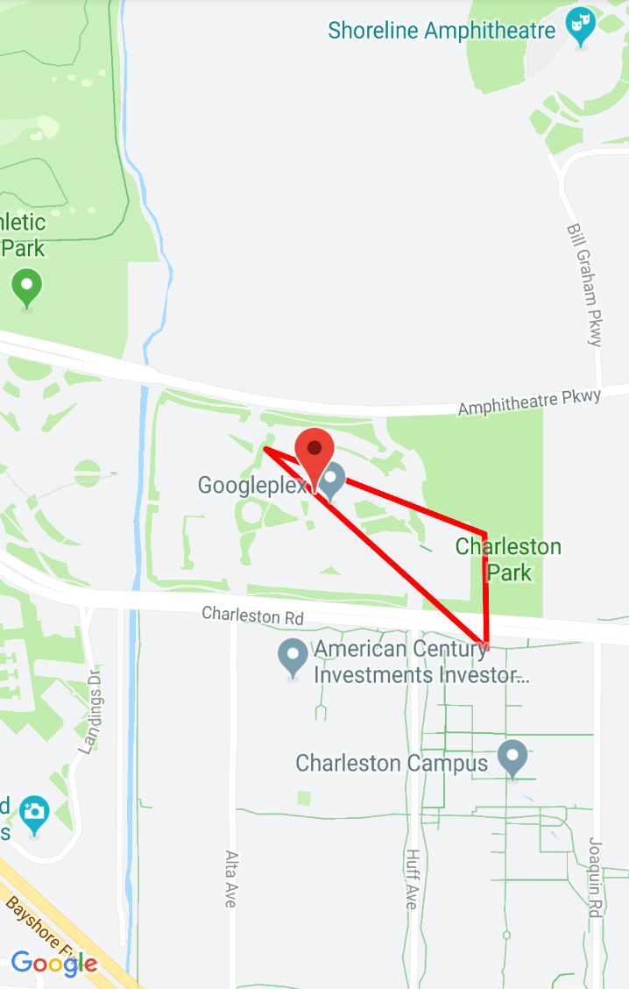
Shapes
Notes:
Shapes: You can add polylines, polygons, and circles to the map.

Slide 42
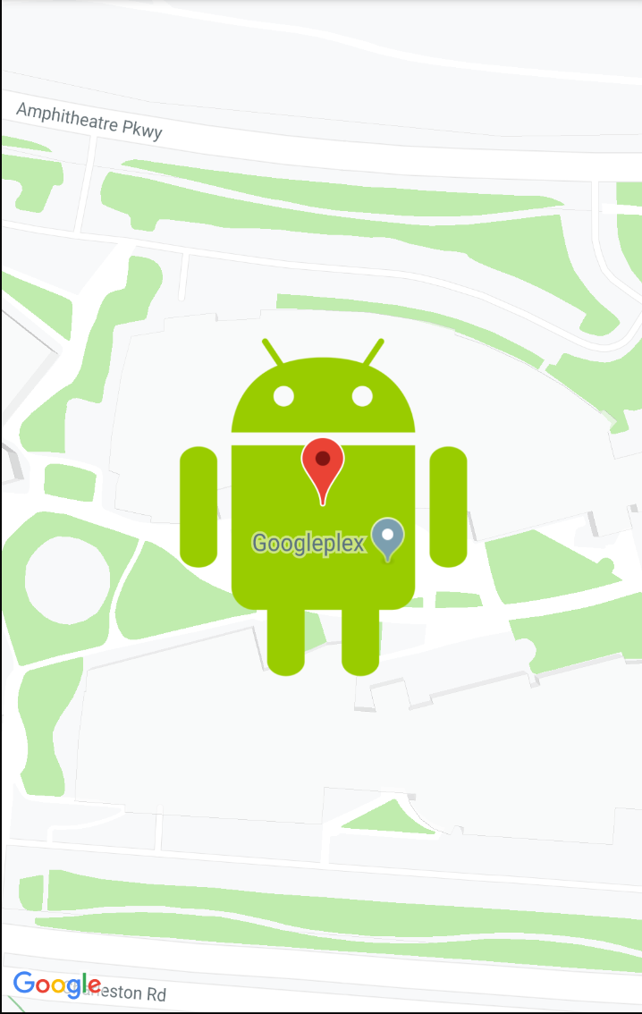
GroundOverlay
Notes:
GroundOverlay objects: A ground overlay is an image that is fixed to a map. Unlike markers, ground overlays are oriented to the Earth's surface rather than to the screen. Rotating, tilting, or zooming the map changes the orientation of the image. Ground overlays are useful when you wish to fix a single image at one area on the map
In this step, you'll add a ground overlay in the shape of an Android to your home location.

Slide 43

Notes:
Download this Android image and save it in your res/drawable folder. (Make sure the file name is android.png.)

Slide 44
Demo
Notes:
In onMapReady(), after the call to move the camera to your home’s position, create a GroundOverlayOptions object. Assign the object to a variable called homeOverlay:
Use the BitmapDescriptorFactory again, this time using the .fromResource() method
This method Creates a BitmapDescriptor using the resource ID of a Bitmap image.
Pass the object into the image() method of the GroundOverlayOptions object:
Set the position property for the GroundOverlayOptions object by calling the position() method. Pass in the home LatLng object and a float for the width in meters of the desired overlay. For this example, a width of 100 m works well:
Call addGroundOverlay() on the GoogleMap object. Pass in your GroundOverlayOptions object:
Run the app. Try changing the code for the zoom when moving the camera to 18f to see the Android image as an overlay.

Slide 45
Enable location tracking

Slide 46
Demo
Notes:
In the AndroidManifest.xml file, verify that the FINE_LOCATION permission is already present. Android Studio inserted this permission when you selected the Google Maps template.
In MapsActivity.kt, create a REQUEST_LOCATION_PERMISSION variable.
To enable location tracking in your app, create a method in the MapsActivity.kt called setMyLocationEnabled() that takes no arguments and doesn't return anything.
Check for the ACCESS_FINE_LOCATION permission. If the permission is granted, enable the location layer. Otherwise, request the permission:
Call setMyLocationEnabled() from the onMapReady() callback to enable the location layer.
Override the onRequestPermissionsResult() method. This Callback is the result from requesting permissions.
Run the app. There should be a pop up requesting access to the device's location. Allow the permission.
Note that this pop up may look different if you are not running the recommended API 29.
The map will now display the device's current location using a blue dot. Notice that there is a location button on the top right. If you move the map away from your location and click on this button it will center the map back to the device location.
You can change the emulator’s location using the menu and clicking the three dots.
From there you can input your desired latitude and longitude and click send.

